Slide 1
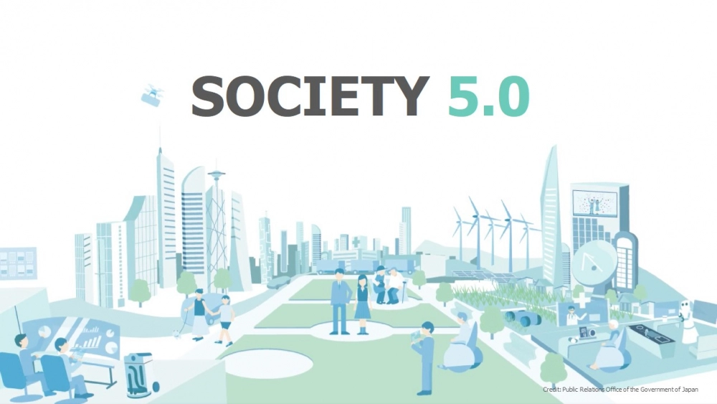
AI, Block Chain and Society 5.0:
Smart Trading Base on Distributed Consensus and Recommendation System
MOCHAMAD HARIADI, PHD
Lab. Telematika, Dept. Teknik Komputer
Institut Teknologi Sepuluh Nopember Surabaya

Slide 2
Agenda
Society 5.0
Block Chain Distributed Consensus
AI Recommendation System
Road Ahead Discussion ➔ SMART TRADING

Slide 3

background
Society 5.0 - A new model for an ageing society?
Professor Harayama Yuko
ソサエティー5.0
Society 5.0 is a new concept launched by Japan in its 5th Science and Technology Basic Plan (2016–2020), as a way by which to guide and mobilize action in science, technology and innovation (STI) to achieve a prosperous, sustainable, and inclusive future.

Slide 4
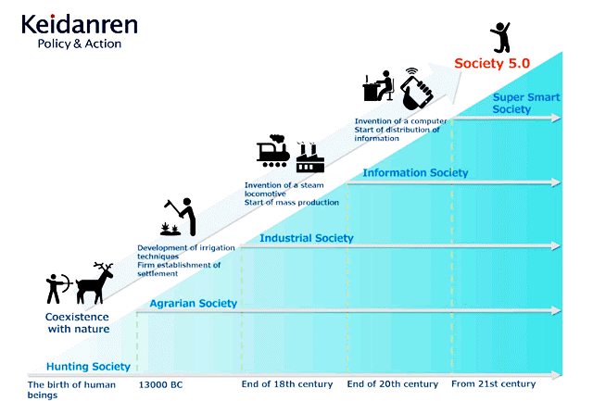
Japan Business Federation
is a comprehensive economic organization with a membership comprised of 1,461 representative companies of Japan, 109 nationwide industrial associations and the regional economic organizations for all 47 prefectures (as of April 1, 2021).

Slide 5
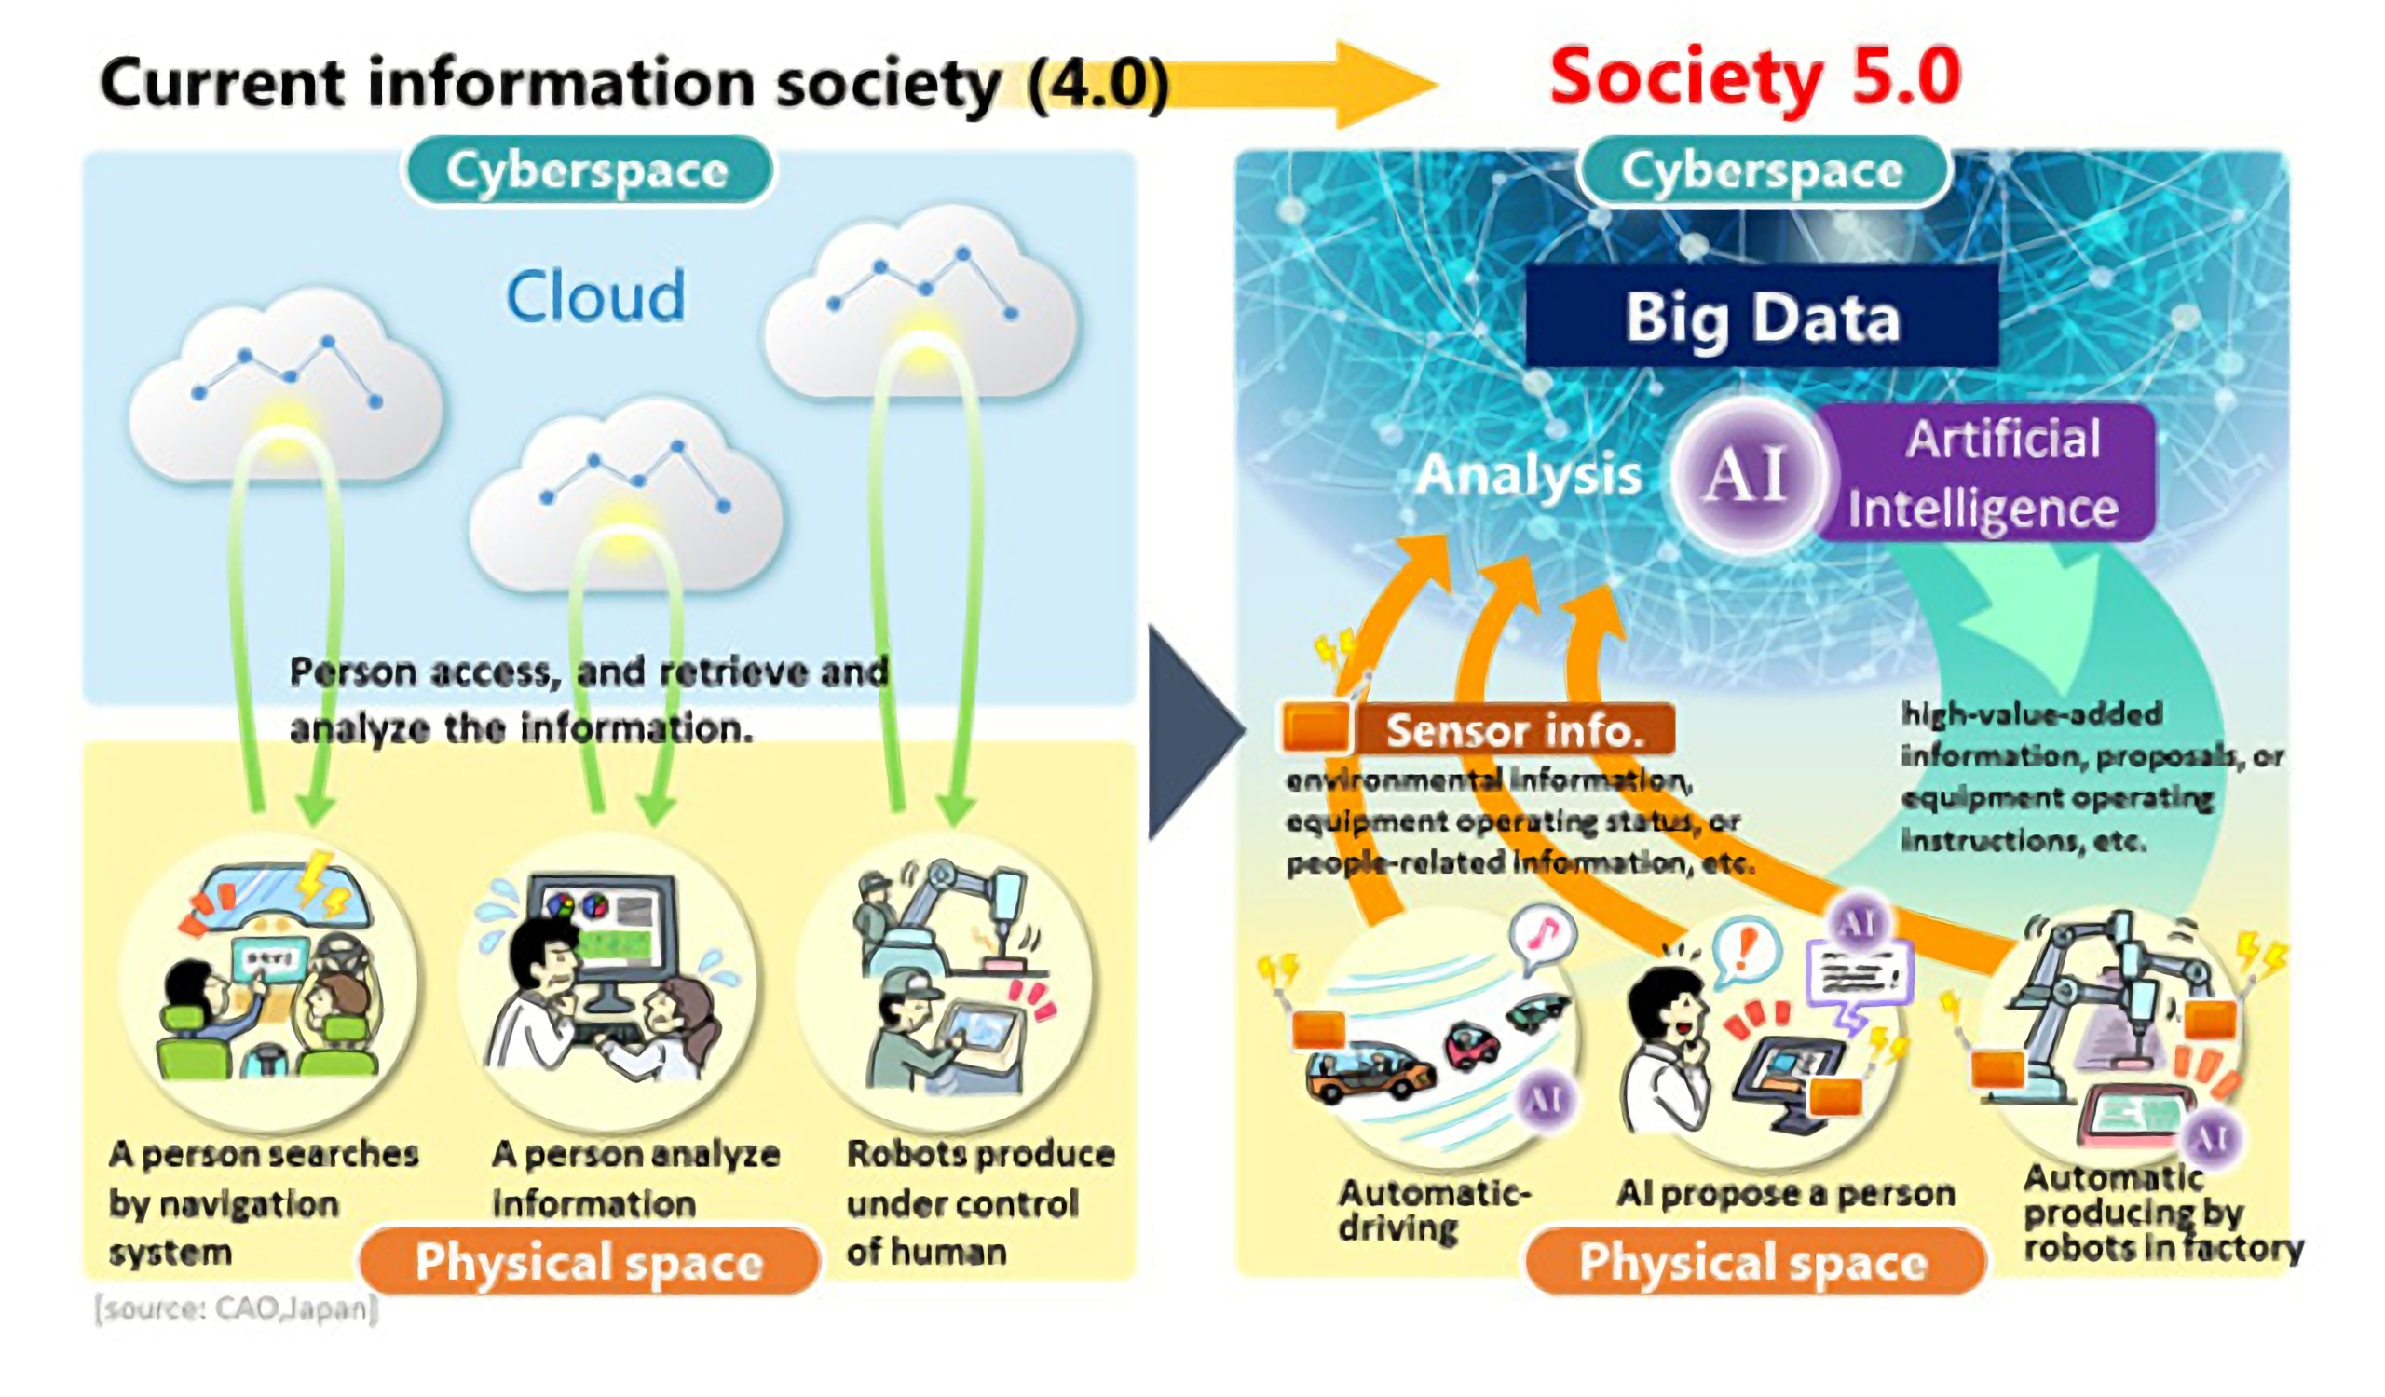

Slide 6
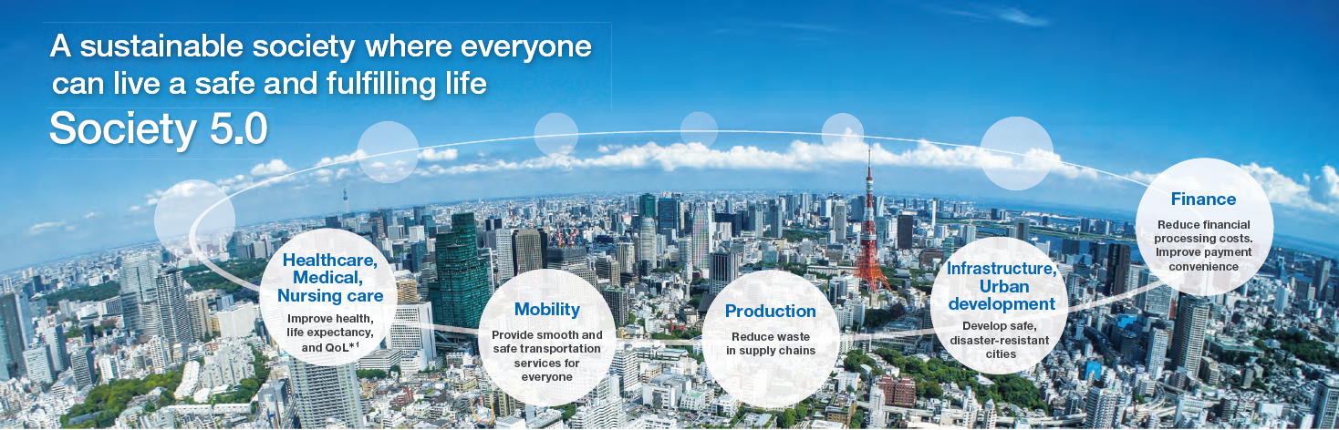
HITACHI SOLUTION

Slide 7
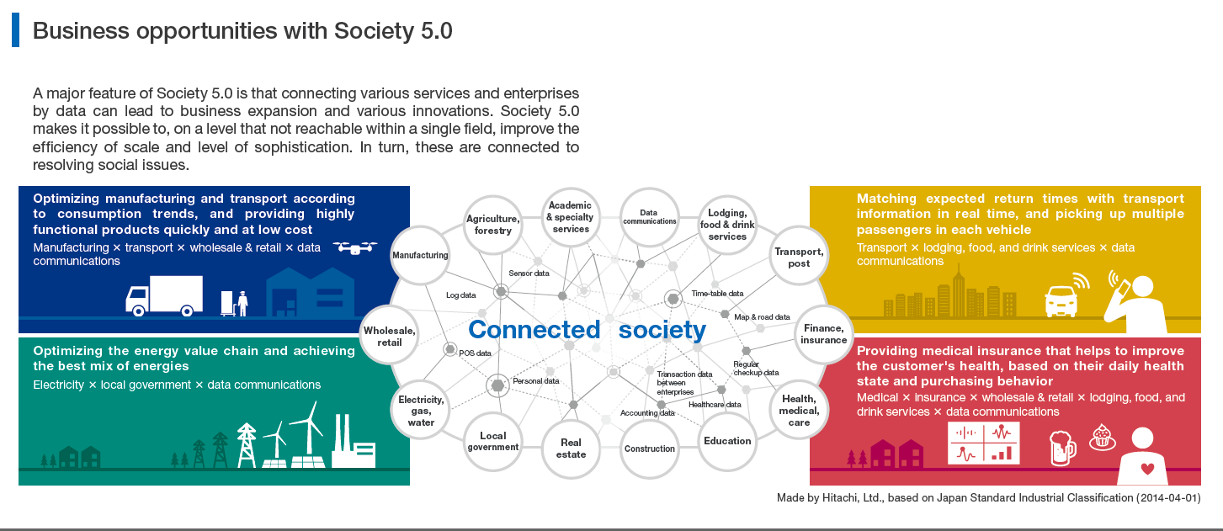

Slide 8
Blockchain

Slide 9
Agenda
Society 5.0
Block Chain Distributed Consensus
AI Recommendation System
Road Ahead Discussion ➔ SMART TRADING

Slide 10
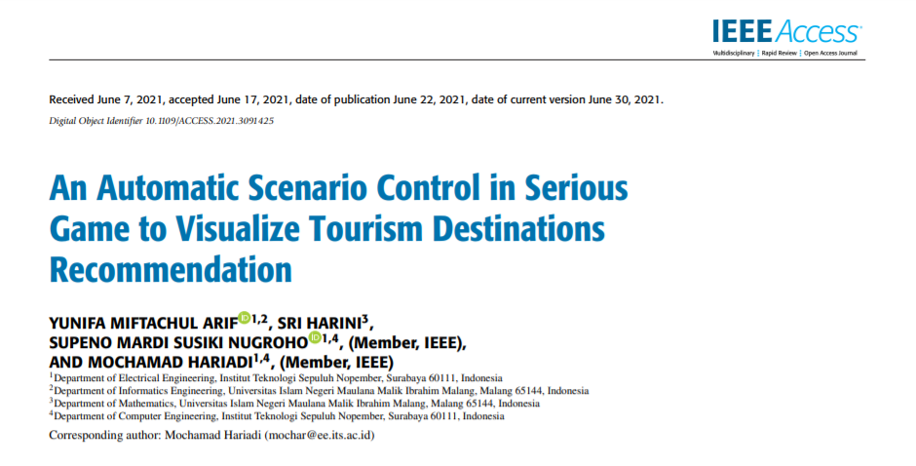

Slide 11

Blockchain
A distributed and decentralized data sharing architecture model
Secure data structure is Provided
Block structure
  block number,
  nonce,
  data,
  Timestamp
  previous hash,
  current hash
SHA256

Slide 12
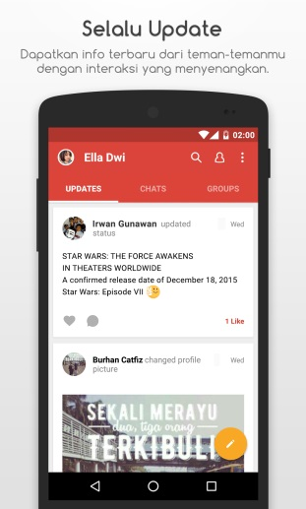
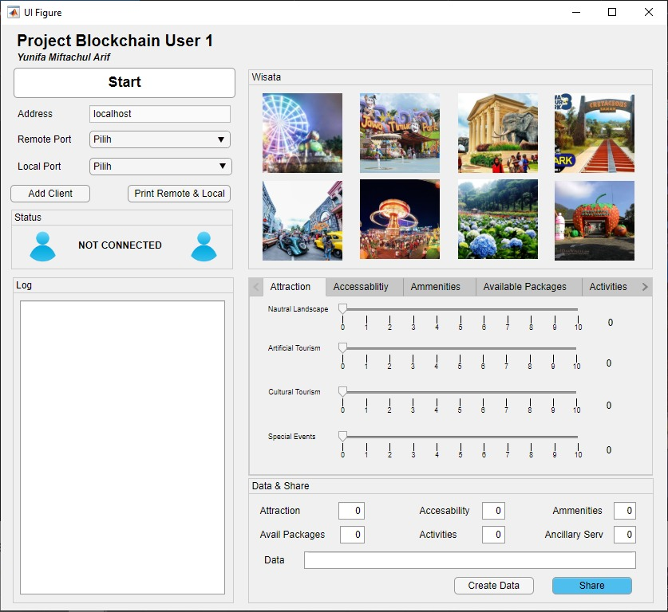
DISTRIBUTED CLOUD USING BLOCKCHAIN
CLIENT 3
DATA SHARING
SHA256
CLIENT 4
CLIENT 2
BROADCAST AND VERIFICATION
CLIENT 1

Slide 13
BLOCKCHAIN CONSENSUS ➔ PROOF OF WORK
LOCAL CONSENSUS
LOCAL CONSENSUS
LOCAL CONSENSUS
LOCAL CONSENSUS
LOCAL CONSENSUS
LOCAL CONSENSUS

Slide 14
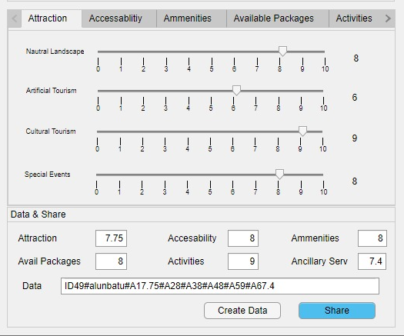
EXAMPLE
Tourism Destinations Rating Data
Every tourist can enter the rating assessment of all the variables and components owned by each tourism destinations

Slide 15
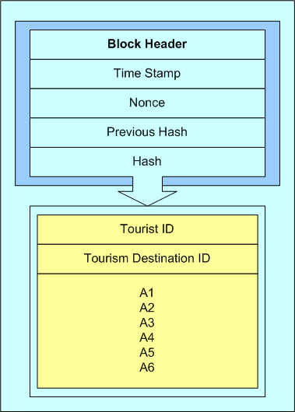
Block Structure

Slide 16
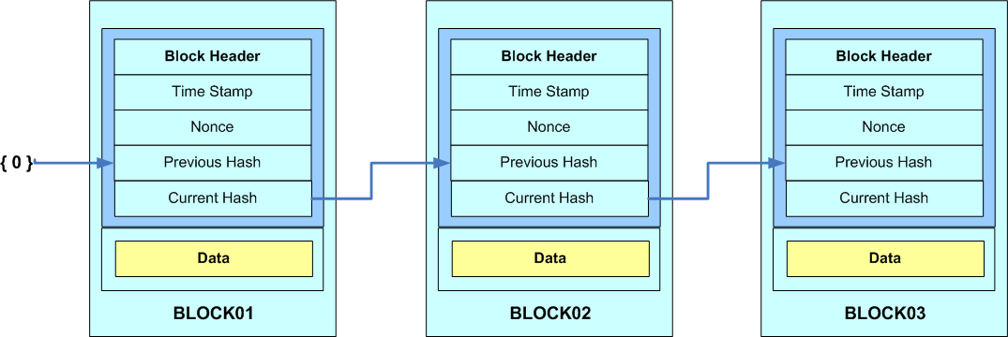
Chain of Block

Slide 17
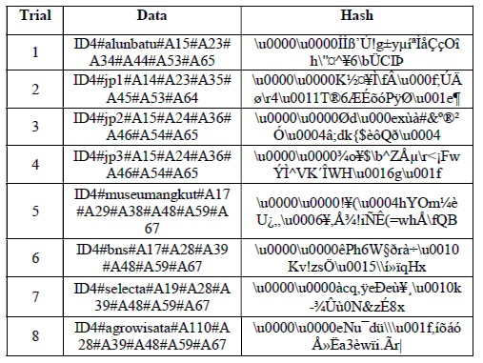
The Result of Hashing Data Process

Slide 18
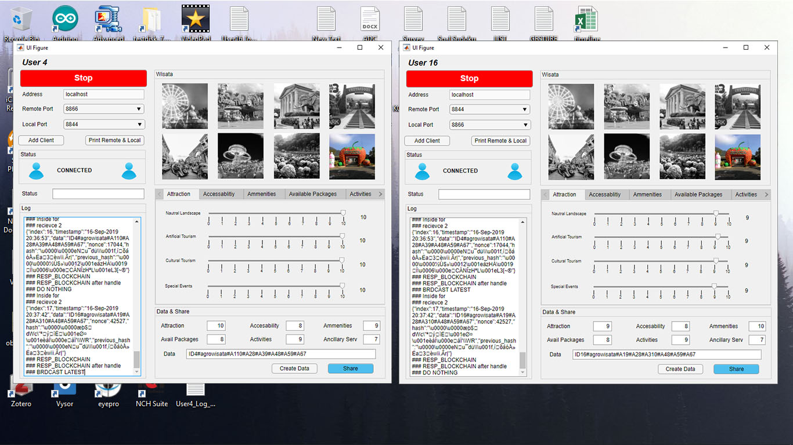
Communication Example Between Two Nodes using Proof of Work Consensus (PoW)
PoW

Slide 19
Agenda
Society 5.0
Block Chain Distributed Consensus
AI Recommendation System
Road Ahead Discussion ➔ SMART TRADING

Slide 20
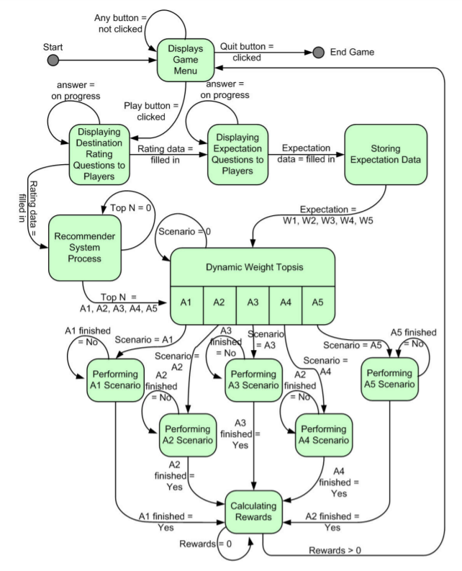
AI recommendation system

Slide 21

BLOCKCHAIN CONSENSUS➔ AI RECOMMENDATION SYSTEM
LOCAL CONSENSUS
Recommendation
LOCAL CONSENSUS
LOCAL CONSENSUS
Recommendation
AI
RECOMMENDATION
SYSTEM
Recommendation
LOCAL CONSENSUS
LOCAL CONSENSUS
LOCAL CONSENSUS
Recommendation
Recommendation
Recommendation

Slide 22
Agenda
Society 5.0
Block Chain Distributed Consensus
AI Recommendation System
Road Ahead Discussion ➔ SMART TRADING

Slide 23

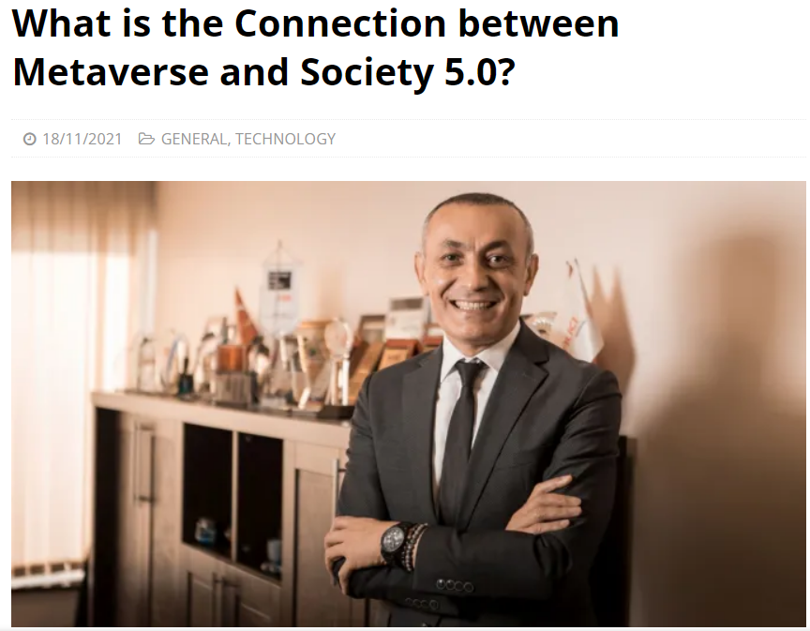
Road ahead discussion
SMART TRADING
NFT
Halıcı Group CEO and Society 5.0 Academy President Dr. Hüseyin Halıcı

Slide 24
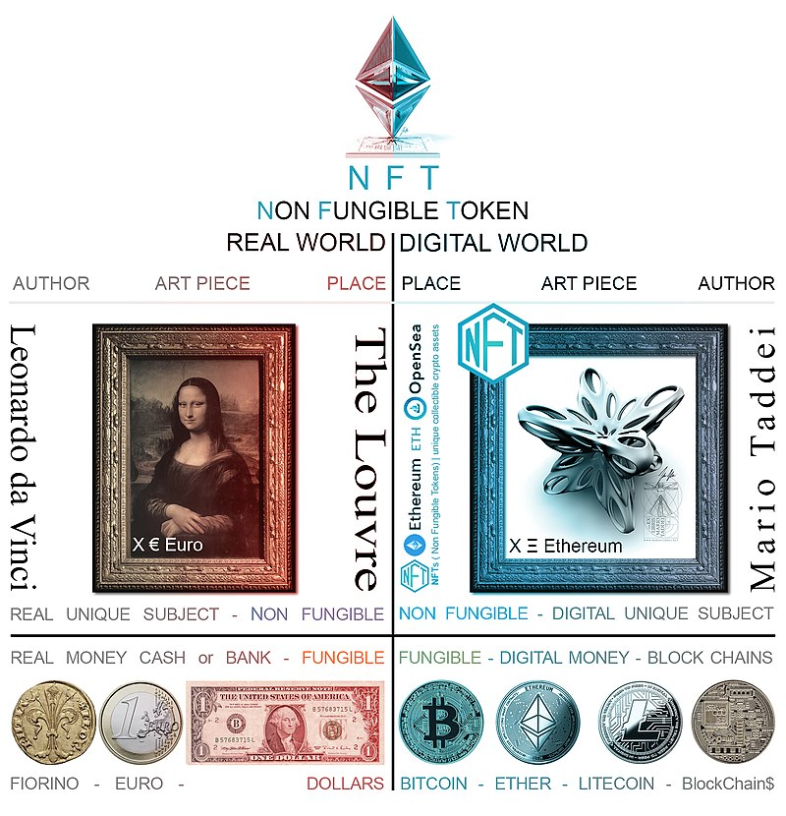
PHYSICAL SPACE
CYBER SPACE

Slide 25
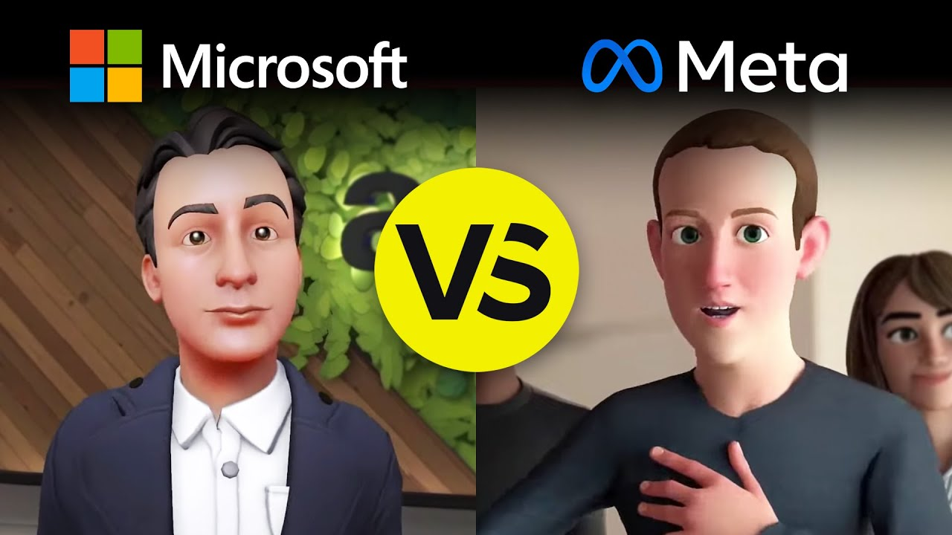

Slide 26

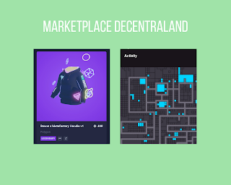

Slide 27
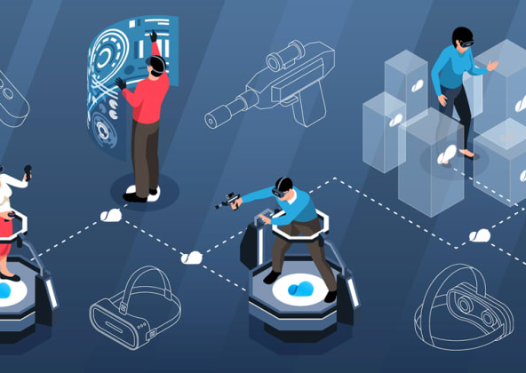
CLOSING STATEMENT
Society 5.0 ➔ Metaverse
Smart Trading ➔ NFT
A I

