Slide 1
SUPPORTING TEACHER PROFESSIONAL DEVELOPMENT AT SCHOOLS
SEPTEMBER 2021

Slide 2
<ON-PAGE TRACKER>
<STICKER>
OVERVIEW
    Teacher Education and Professional Development
1
    Teacher Learning and Sharing Program
2
    Current Condition of English Teacher in Indonesia
3
    Challenges for Future
4

Slide 3
CURRENT TEACHER EDUCATION
Pre-service teacher education: 4 years study at universities after graduated from secondary education
Certification/teacher professional education (PPG)
  Pre-service PPG (certified before being assigned as a teacher)
  In-service PPG (certified after becoming - existing as- a teacher)
In-service: Teacher Professional Development
SUPPORTING TEACHER PROFESSIONAL DEVELOPMENT AT SCHOOLS

Slide 4
TEACHER CERTIFICATION:
TEACHER PROFESSIONAL EDUCATION (PPG)
Under-qualified Teacher
Low Competent Teacher
Teacher in the era of industrial revolution 4.0 who has capabilities in managing innovative and joyful learning
Critical thinking and problem solving
information and communication technology literacy
contextual learning skill
communication and collaborative skill
creativity and innovative skill
information and media literacy

Slide 5
TEACHER PROFESSIONAL EDUCATION (PPG)
Create teacher as a professional educator who has faith in God the only One, knowledgeable, adaptive, creative, innovative, and competitive with the core tasks are educating, teaching, guiding, directing, training, assessing and evaluating students.
Activities and models of teaching and learning process referring to Problem-Based Learning principle
Ability in problem solving, critical thinking, and creative as a candidate of professional teacher
Activities and models of teaching and learning process referring to
Project-Based Learning).

Slide 6
LEARNING OBJECTIVES
Graduate competence standard of PPG study programs covered attitude, knowledge and skills
Learning objectives of the study program
Learning objectives of the subject matter of the program
CURRICULUM STRUCTURE
No | Subject | Credit | Mode
1. | Subject Matter Comprehension | 5 | Tutorial/Lecturing
2. | Developing Teaching Instruments | 3 | Seminar/ Workshop
3. | Field Teaching Practicum | 4 | Field study
Total |  | 12

Slide 7

LEARNING PROCESS
CONTENT KNOWLEDGE OF THE SUBJECT MATERIAL
Self-study and collaboratively
DEEPENING SUBJECT MATTER KNOWLEDGE
(5 CREDITS)
TEACHING MATERIAL DEVELOPMENT
(3 CREDITS)
COMPREHENSIVE TEST
FIELD TEACHING PRACTICUM AT SCHOOL
(4 CREDITS)
Teaching and learning processes using Learning Management system emphasising on learning collaboratively.

Slide 8
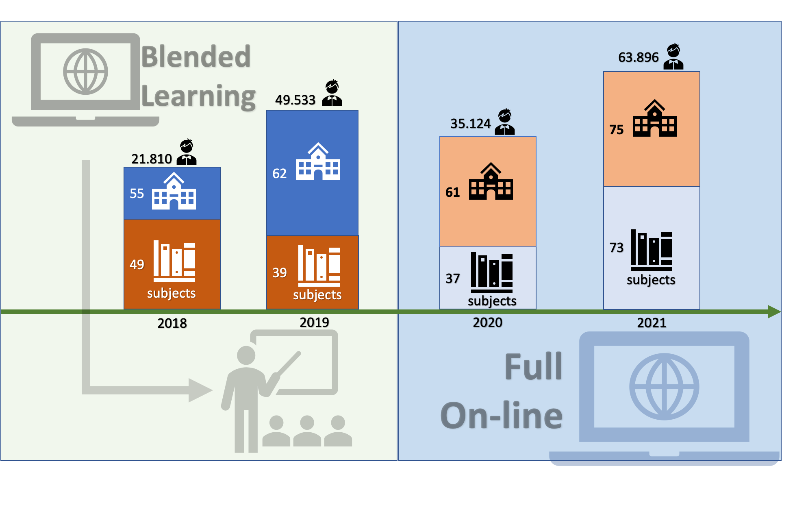
From blended to fully online learning

Slide 9
Reviewing extensive Teacher Professional Development literature, Desimone (2009) proposes a conceptual framework with 5 critical features of effective TPDs:
Content focus - focus on subject matter content and how students learn that content
Active learning - Opportunities for teachers to engage in active learning
Coherence - consistent with teachers’ knowledge and beliefs and with state reforms and policies
Duration - No agreement about the “tipping point” for duration, suggests for activities spread over a semester (or intense summer institutes with follow-up during the semester) and include 20 hours or more of contact time.
Collective Participation - participation of teachers from the same school, grade, or department, or professional learning communities

Slide 10
TRANSFORMING TEACHER PROFESSIONAL EDUCATION
Improving the selection/recruitment process: e.g assessing passion, values, etc.
Emphasizing on the foundation of competencies to become a professional teacher
Problem-based learning, project-based learning, school-based context
Curriculum Structure: core, selective, and elective courses

Slide 11
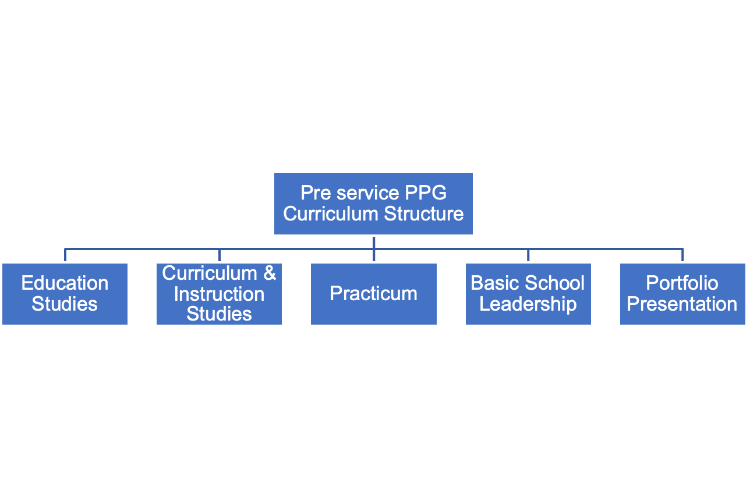
TRANSFORMING TEACHER PROFESSIONAL EDUCATION

Slide 12
<ON-PAGE TRACKER>
<STICKER>
OVERVIEW
    Teacher Education and Professional Development
1
    Teacher Learning and Sharing Program
2
    Current Condition of English Teacher in Indonesia
3
    Challenges for Future
4

Slide 13
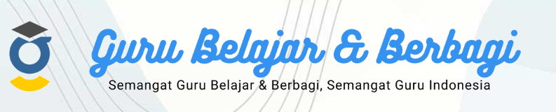
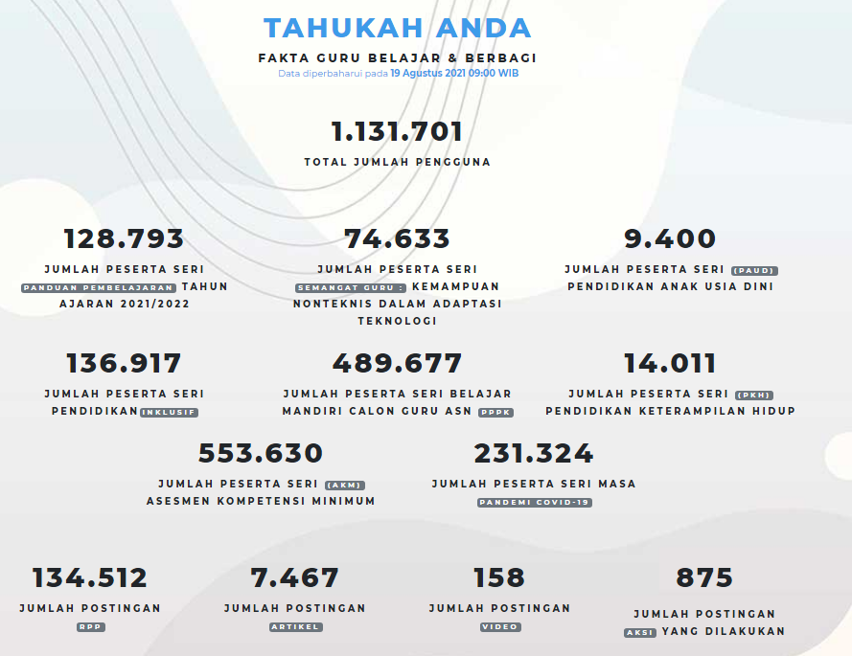
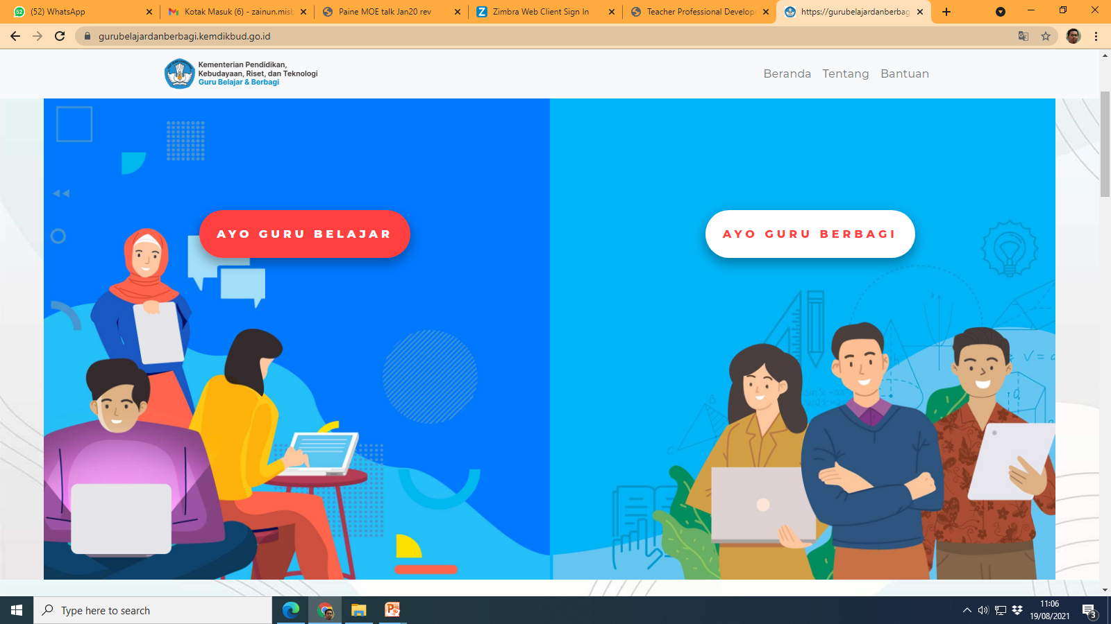
In-service Teacher Professional Development during Pandemic Covid 19 in Indonesia

Slide 14
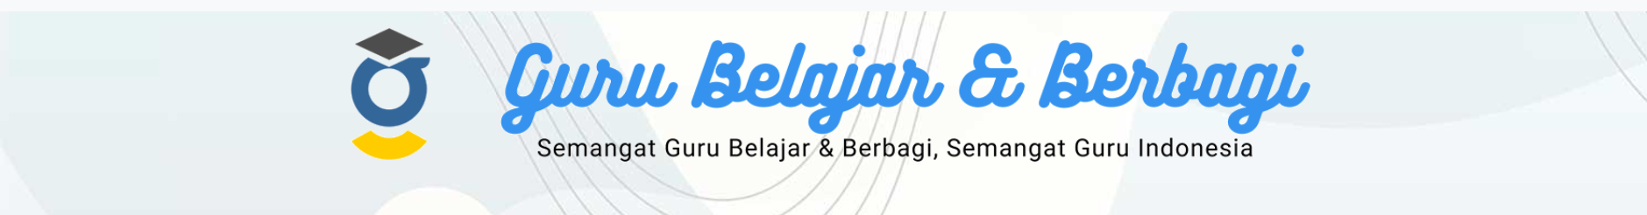



PROGRAM GURU BELAJAR DAN BERBAGI
Teacher Learning and Sharing program is a platform provided by the Ministry to facilitate teachers during the Covid-19 pandemic.
The program can reach all corners of the Indonesian territory which consisted of many islands, and stimulate a spirit of mutual cooperation that reflects the Indonesian nation.
The program offers teacher to learn and to upgrade continuously to develop characters of adaptive, innovative and creative human being in an easier, more flexible, more challenging and more collaborative way.
Teacher might access easily from a special domain in https://gurubelajardanberbagi.kemdikbud.go.id
More than 1 million teachers have joined the online learning program independently, shared their knowledge and experiences, and shared good teaching practices.

Slide 15
PROGRAM: AYO GURU BELAJAR
Ayo Guru Belajar (Teacher Learning Program) facilitated teachers to learn topics that are relevant to the problems during and post Covid-19 pandemic faced by teachers.
The Teacher Learning Program is designed based on the principles of relevance, freedom to learn, flexible, visuals for learning and adaptive technology.
The Teacher Learning program has developed series of modules:
  Covid-19 pandemic;
  Life Skills Education;
  Minimum Competency Assessment;
  Self-Learning series for Prospective ASN PPPK teachers (Government Employees with Work Agreement);
  Early Childhood Education;
  Inclusive Education;
  Non Technical aspect in Technology Adaptation Capability;
  Learning Guideline for the 2021/2022 Academic Year;

Slide 16

PROGRAM: AYO GURU BERBAGI
Ayo Guru Berbagi (Teacher Sharing Program) is a crowdsourcing forum for and from educators to share ideas in organizing teaching and learning processes during the pandemic, either by offline, online, or mixed methods.
Teachers were stimulated to share their lesson plans, learning materials/resources, and articles for reflecting their teaching practices.
Both Ayo Guru Belajar and Ayo Guru Berbagi programs were designed to facilitate learning and sharing so that Indonesian children get the best education from the best teachers.
Because we believe,
the Spirit of Learning and Sharing is
the Spirit of Indonesian Teachers!

Slide 17
<ON-PAGE TRACKER>
<STICKER>
OVERVIEW
    Teacher Education and Professional Development
1
    Teacher Learning and Sharing Program
2
    Current Condition of English Teacher in Indonesia
3
    Challenges for Future
4

Slide 18
ENGLISH TEACHER IN INDONESIA
In 2021, 2041 English Teachers participated in in-service teacher professional education
Working with the British Council, we assessed the proficiency of English language. 400 teachers participated.
Results show the need for improving English teacher ability in English proficiency.

Slide 19


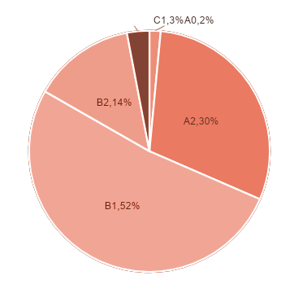
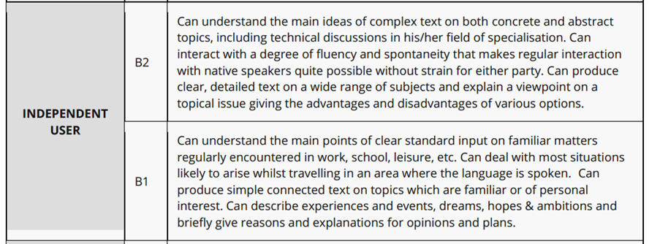
RESULT (N=400)

Slide 20
<ON-PAGE TRACKER>
<STICKER>
OVERVIEW
    Teacher Education and Professional Development
1
    Teacher Learning and Sharing Program
2
    Current Condition of English Teacher in Indonesia
3
    Challenges for Future
4

Slide 21
TEACHER EDUCATION IN THE FUTURE
Teacher educators should be more adaptive with technology and responsive to the changing world.
The fast spreading of COVID-19 pandemic emerged the global consciousness that the world today is truly interconnected. Teacher education, therefore, should stimulate teachers to have strong awareness related to multicultural, boundary-crossing, and inclusive education.

Slide 22
LESSON LEARNT
Responsive toward the development of technology is vital to ensure the educational process in teacher education work well.
Calls for more comprehensive approaches to the pedagogy of online education, integrating technology to support teaching and learning activities.
Strong education policy is important but it does not guarantee the successful implementation.
The need for collaborating with various stakeholders

Slide 23

TERIMA KASIH

