Slide 1
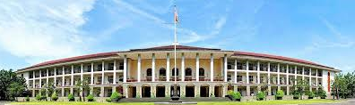
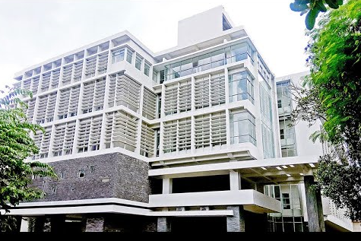
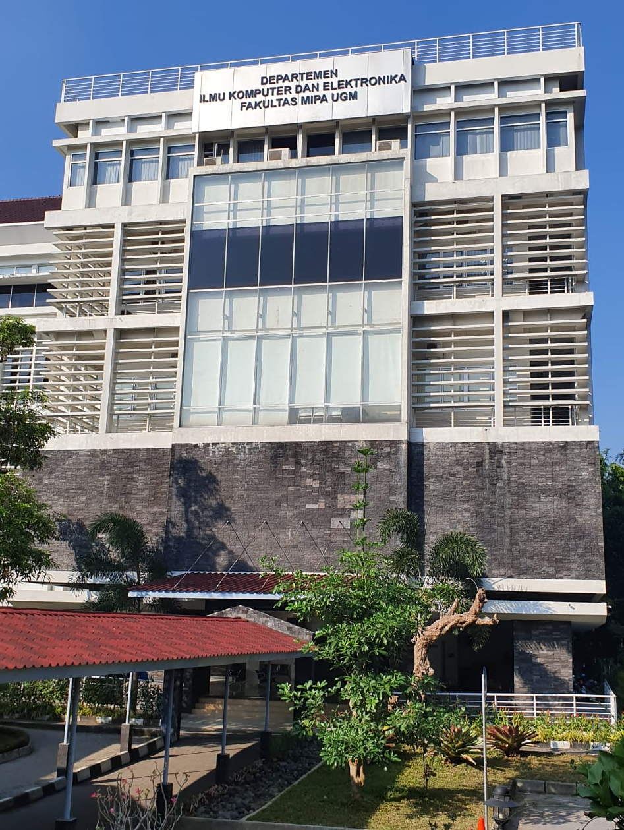
Peran
Kecerdasan Artificial
Untuk Bidang
Kesehatan
Disampaikan Pada Seminar Nasional Teknologi dan Multidisiplin Ilmu
Sri Hartati
Departemen Ilmu Komputer dan
Elektronika FMIPA UGM

Slide 2
Agenda
Apa AI itu?
Tugas-tugas AI
Teknik AI
Aplikasi AI
Beberapa Contoh Aplikasi

Slide 3
What is Artificial Intelligence
‘‘Artificial Intelligence’’ (AI) was first coined by John McCarthy for a conference on the subject held at Dartmouth in 1956 as ‘‘the science and engineering of making intelligent machines’’ (Society for the Study of Artificial Intelligence and Simulation of Behavior, 2018)
General AI is an important field of computer science that seeks to create complex machines with characteristics of human intelligence.
General AI has machines that can think and reason and even see and hear like humans (Copeland, 2016).
Narrow AI performs specific tasks as well as, or better than, humans can (Copeland, 2016). Examples of such narrow AI include speech recognition, facial recognition, etc.

Slide 4


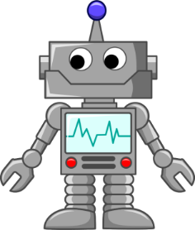




Apa itu Kecerdasan Artificial (AI)
Input:
Data
Sensors
Citra
Audio
Video
Artificial Intelligence
Output:
Action
Movement
Text

Slide 5
Tasks of AI
AI
learning
predicting
classififying/
clustering
extracting information
recognizing/identifying and interpretation
inferencing

Slide 6
AI Techniques
  Knowledge-based approaches
  Machine-learning approaches

Slide 7
Knowledge Base
The knowledge base approaches that compute reasons about statements deemed to be true about the world
  An operator/programmer implements such statements in terms of rules
  A logical inference engine processes these rules to draw patterns/capture knowledge about the world

Slide 8
Machine Learning
Machine learning uses statistical concepts to draw patterns from vast amount of data
As opposed to encoding all human knowledge into a knowledge base, machine learning extracts both subjective and intuitive knowledge from raw data
Notes:
.

Slide 9
Machine Learning
Machine learning approaches:
  Supervised learning
  Unsupervised learning
  Reinforcement learning
All can utilize deep learning based on whether they are using more than one neural network layers
Notes:
In supervised learning, the raw data (or input features) are labeled and the algorithm is trained to understand or recognize the meaning of the input.
The algorithm is tested and evaluated against unlabeled raw data to see how well it makes accurate predictions.
==

Slide 10
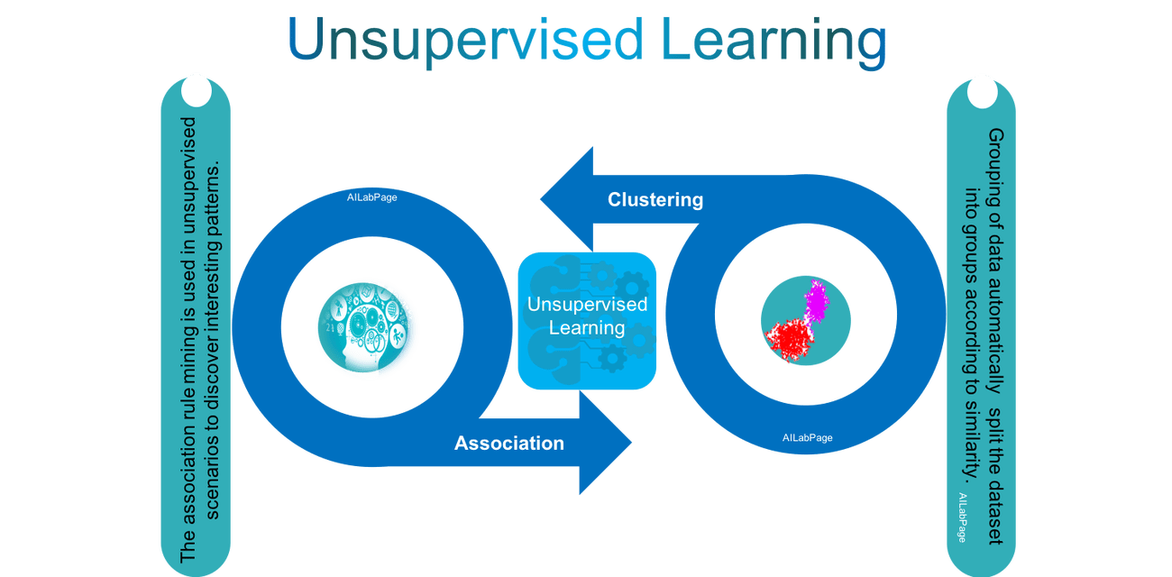
Vinod Sharma (2018)

Slide 11
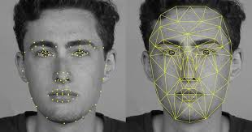
Deep Learning
An image of a person can be recognized through simpler concepts such as corners and contours, which in turn are derived from edges and strokes, etc.

Slide 12
Skills for success in AI & ML
Working with AI requires an analytical thought process and the ability to solve problems with cost effective and efficient solutions.
Professionals need technical skills to design, maintain and repair technology and software programs.
Those interested in becoming AI professionals need a education qualification based on foundations of maths, technology, logic and engineering prospective.
Cognitive Science skills.

Slide 13
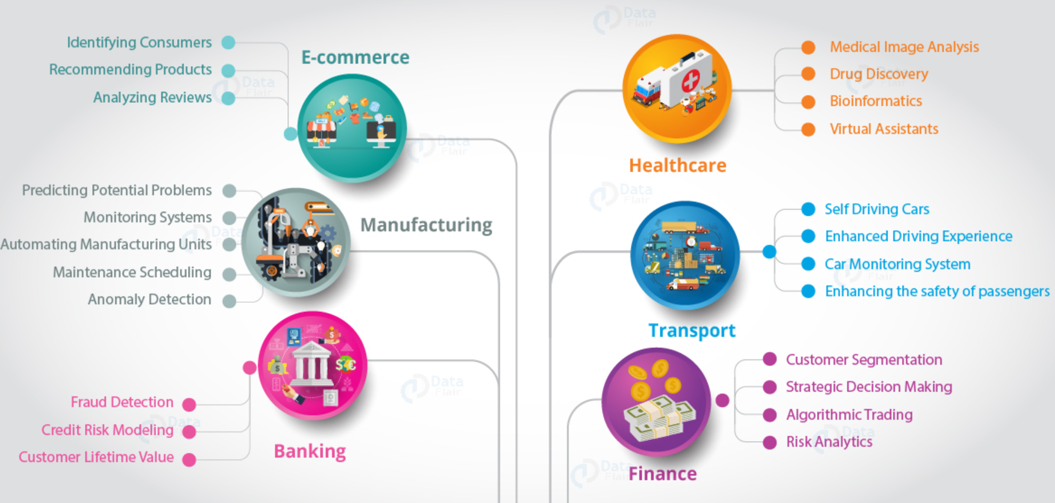
AI applications

Slide 14


Health care system is considered to be consisting of the people, organisations and actions whose prime objective is to promote, restore, endorse or maintain health.
WHO, 2000
OBJECTIVES
Improving people’s health and well being;
Responding to people’s expectations;
Providing protection against the costs of ill-health.

Slide 15
Health care deals with the detection, treatment, analysis, prediction and prevention of a disease, injury, illness or any other
  Roles of AI
  Medical Image Mining
  Computer Aided Diagnosis
  Detection System
  Health Care Systems
Good quality : -services to all people, whenever and wherever they need them.
-provides reliable information for proper diagnosis, on which decisions can be based.
Notes:
Medical Image Mining
Computer Aided Diagnosis System
Computer Aided Detection System
Health Care Systems

Slide 16
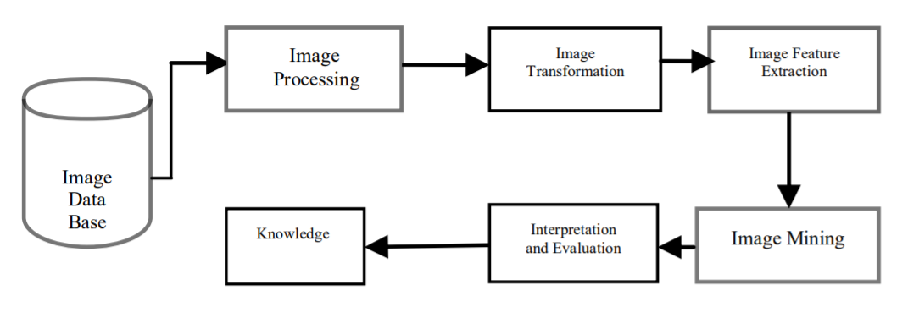
Image mining
Image mining has become necessary to use data mining techniques such as classification and clustering
Helps decision support and prediction systems in the field of healthcare
Help to prepare some methods for diagnosis, prognosis, decision making

Slide 17
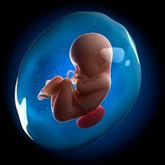
Function Amniotic Fluid
Function
Amniotic fluid as a nutrient for the fetus and fetal protector and the umbilical cord from impact during pregnancy (Ten Broek dkk., 2013).
Also, it is used to protect the fetus and the umbilical cord in the event of an impact as well as pressure on the uterine wall, respectively

Slide 18
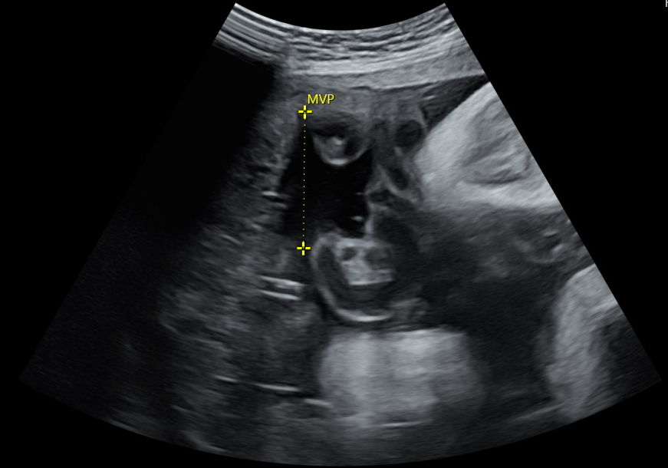
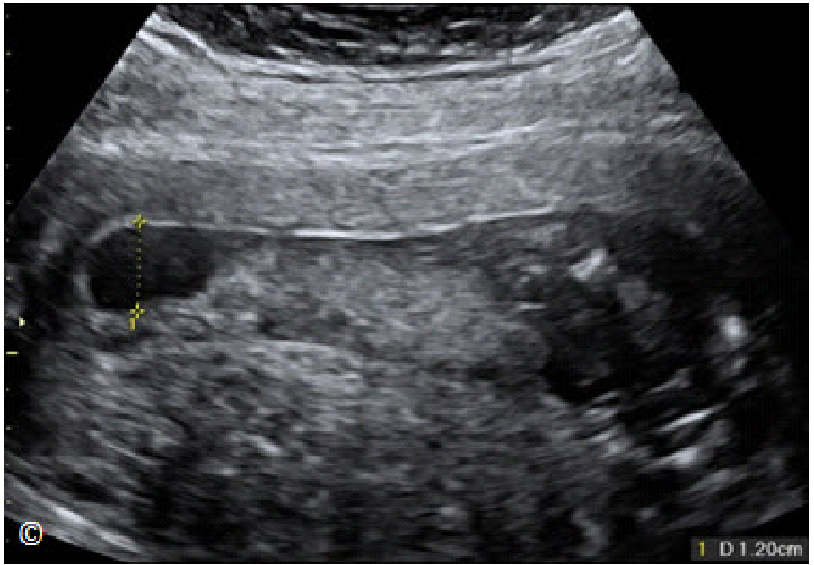
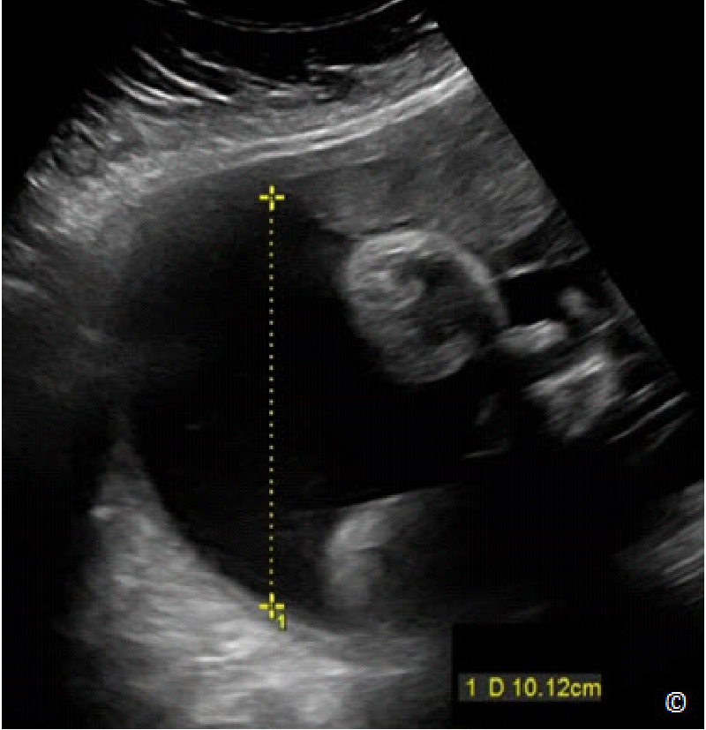
Examination in Amniotic Fluid
Examination
The amount of volume and condition (echogenic or clear) of the fluid is examined by a doctor using an ultrasound machine.
Examination Result
Oligohydramnios is low volume of amniotic fluid (length MVP < 2 cm).
Polyhydramnios is excess of amniotic fluid (length MVP > 8 cm)
Normal (length MVP 2-8 CM)
The Condition of the Amniotic Fluid based on the intensity of gray or opaque in the amniotic fluid area
Normal Clear
Oligohydramnios echogenic
Poligohydramnios Clear

Slide 19
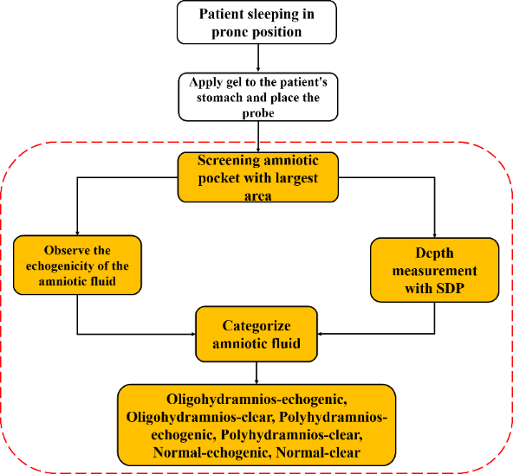
The process of examining amniotic fluid by a doctor
The process of examining amniotic fluid by a doctor
Main Purpose
The process in the red box is a process that assisted completed using our proposed model (combination of rule based and machine learning algorithm (Random Forest) to classify Amniotic Fluid into six categories as Oligohydramnion Clear, Oligohydramnion Echogenic, Poligohydramnion Clear, Polygohydramnion Echogenic, Normal Clear, and Normal Echogenic.

Slide 20
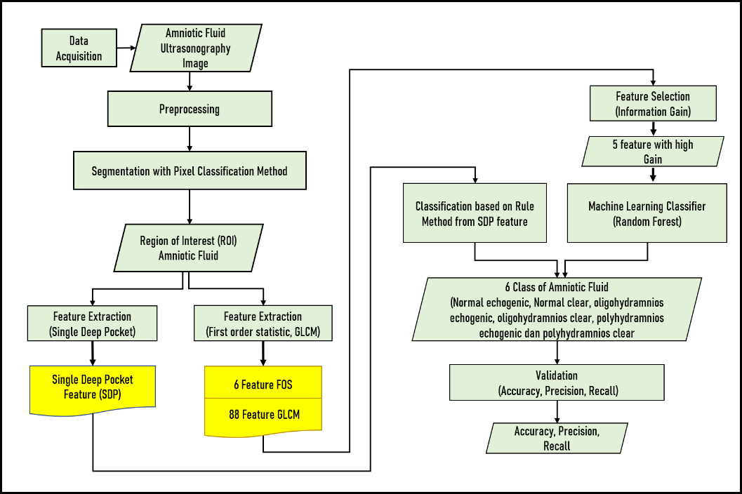
Our Proposed Model for Classification of Amniotic Fluid

Slide 21
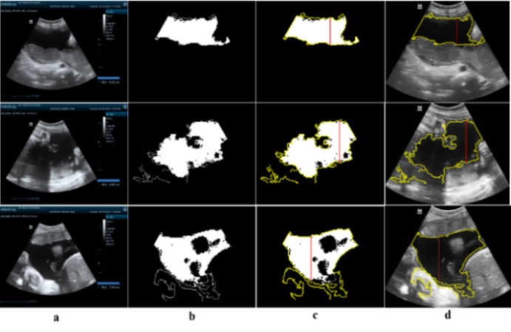
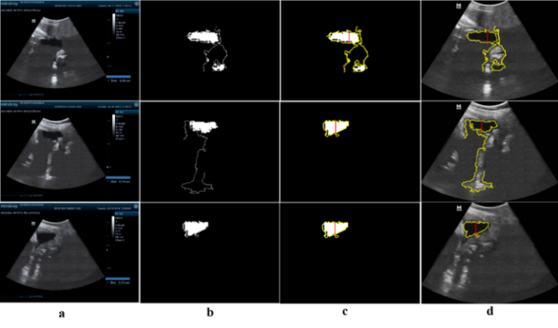
Result of segmentation and SDP method for Volume Amniotic Fluids
The example of SDP feature output on the normal volume class. a. is an original image, b. segmentation results, c. edge and deepest area detection as well as selection respectively, and d. SDP results on original image.
The example of SDP feature output on the oligohydramnios volume class. a. is an original image, b. segmentation results, c. edge and deepest area detection as well as selection respectively, and d. SDP results on original image.

Slide 22
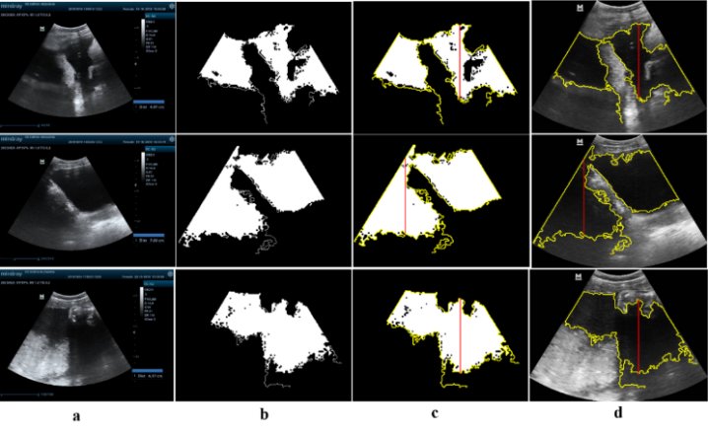
Result of SDP method for Volume Amniotic Fluids
The example of SDP feature output on the poligohydramnios volume class. a. is an original image, b. segmentation results, c. edge and deepest area detection as well as selection respectively, and d. SDP results on original image.

Slide 23
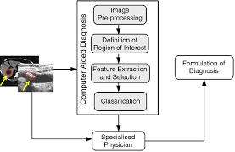
Computer Aided Diagnosis System
The main goal is to identify abnormal signs at an earliest that a human professional fails to find.

Slide 24
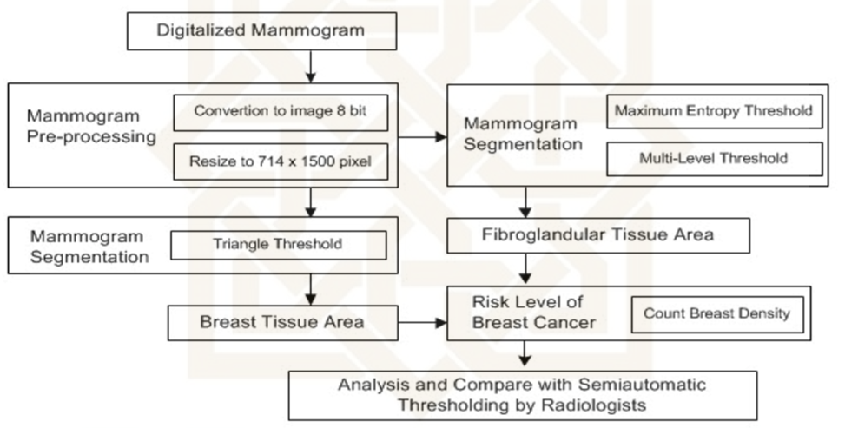
Mammographic Density for identification of risk factor of breast cancer

Slide 25
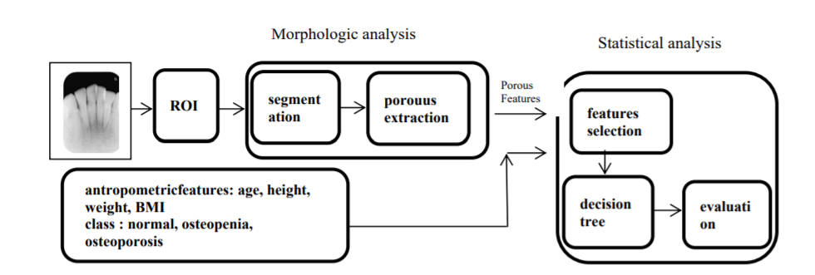
Examples CAD
Combination of Porous Trabecular with Anthropometric Features for Osteoporosis Screening

Slide 26
Mammographic Density for identification of risk factor of breast cancer

Slide 27
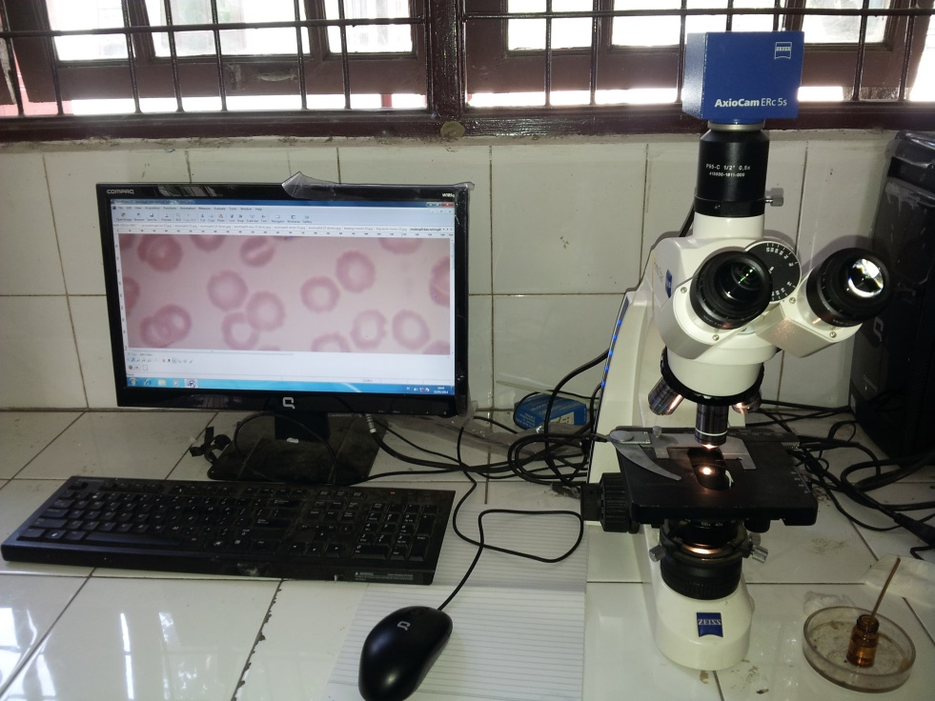
CAD for identification of
Malaria parasite and its life-cycle stages
Blood smear image
ROI
Contrast stretching
Otsu thresholding
Features extraction
Feature database
Diagnostic assistance.
Identifier
Plasmodium and its life stage
Detection of the malaria parasite and its life stage

Slide 28
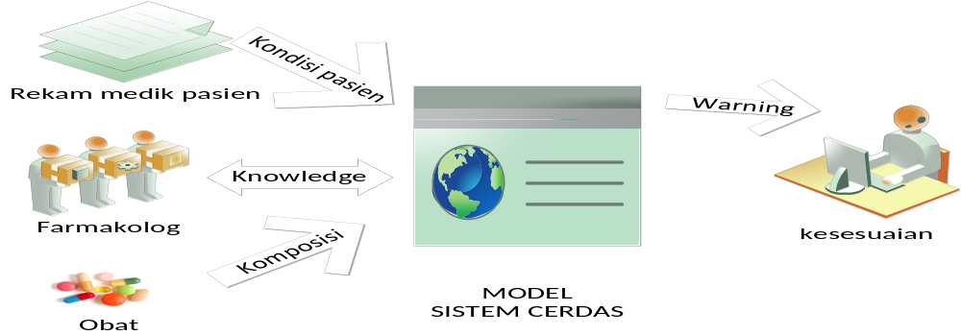
Hypertension Drug Suitability Evaluation Based on Patient's Condition

Slide 29
Clinical Decision Support System
A clinical decision support system (CDSS) is a health information technology system that is designed to provide physicians and other health professionals with clinical decision support(CDS), that is, assistance with clinical decision-making tasks.

Slide 30
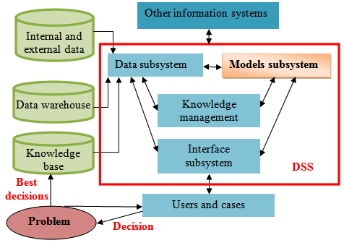
Decision Support System

Slide 31
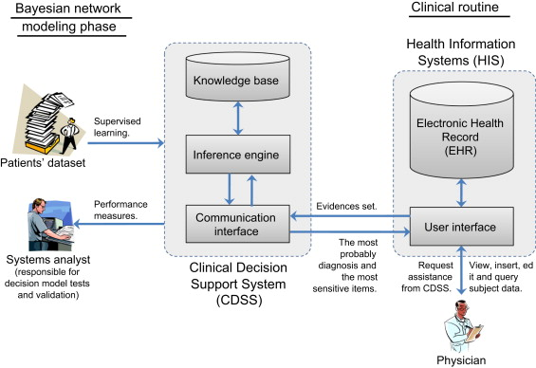
Clinical Decision Support System:

Slide 32
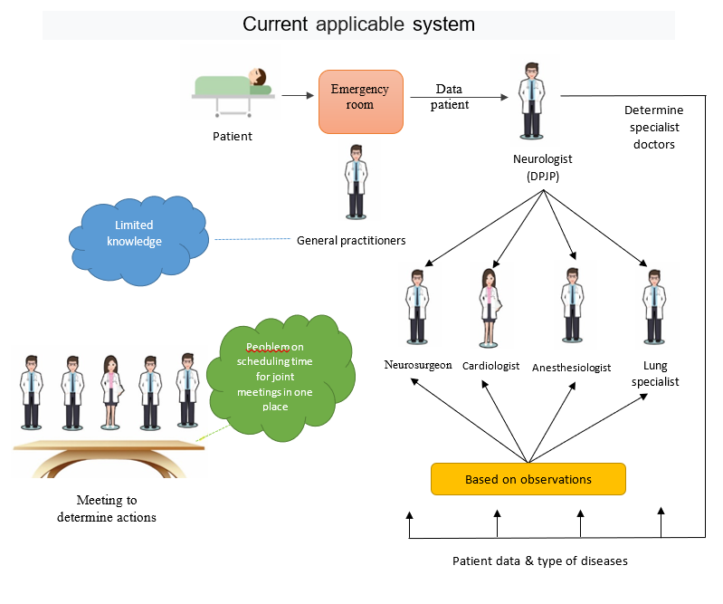
Medical expert group decisions for handling hemorrage stroke

Slide 33
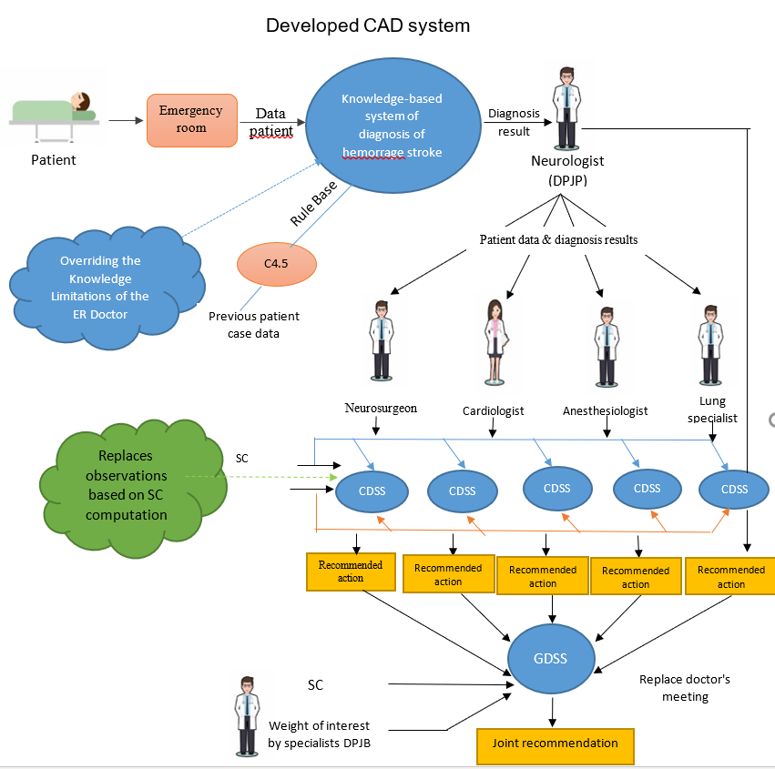
GCDSS: Medical expert group decisions for handling
hemorrage stroke

Slide 34
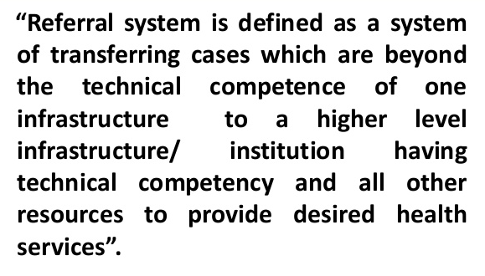
What are the problems?

Slide 35

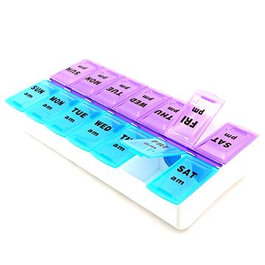
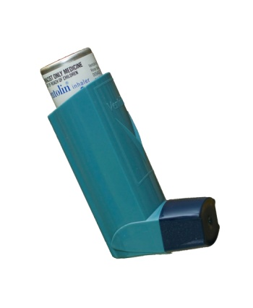
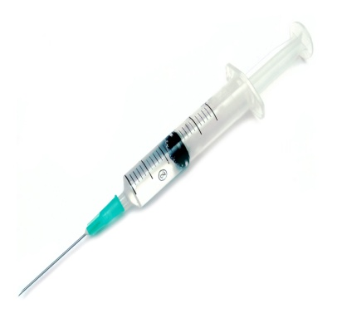
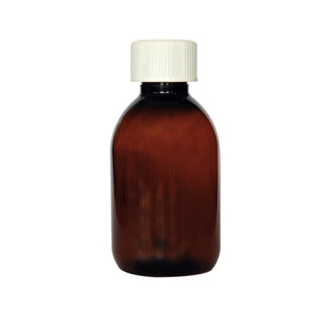

The referral system is still a serious problem
When, where did patient give right medication?
Developed the Smart Refferal System (appropriate to patient’s conditions)
When did I give right medication?
wait to get a referral hospital
Stacking patients in large hospitals
Hospital doctor must do a re-examination.
Hospital rejections:
rooms: full of patients,
unable to handle medically
patient: unable to provide initial guarantee of care.
Difficult to get referral hospital that suits to patient’s conditions

Slide 36
Smart referral system
Generate a smart referral system model to assist doctors or midwives at the community health center (puskesmas) in determining the referral hospital.
Generate parameters to determine referral hospitals that are appropriate to the patient's health, socioeconomic and geographical conditions.
Generate a communication model between the community health center (puskesmas) and the referral hospital.

Slide 37
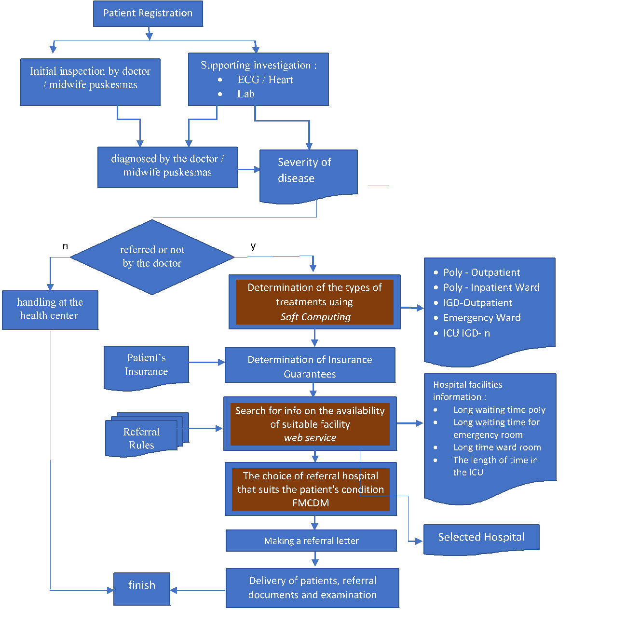
Developed referral system, suitable to patient’s condition (health, socioeconomic and geographical

Slide 38
Communication Model of Puskesmas and Referral Hospitals
The communication model is the ability of the model to:
Contact several hospitals simultaneously.
Puskesmas can send data to several hospitals simultaneously.
Puskesmas can receive data from several hospitals simultaneously.
The approach used is a web service technology with data format with JSON and data exchange methods with Rest

Slide 39


Terima kasih

